Slide 1

BRINDAVAN
INSTITUTE OF TECHNOLOGY & SCIENCE (BITS - KNL)
(Approved by AICTE & Affiliated to JNTUA)
NH-7, PEDDATEKUR, KURNOOL-518218
Department of Computer Science & Engineering
A Project
On
COUNTENANCE BASED BOOM BOX
Presented by
MOHAMMED IMDAAD 162N1A0559
MACHANI SUNIL KUMAR 162N1A0552
M.VINEETH 162N1A0551
Team Name : HUGS for BUGS
Seminar Guide: Seminar Coordinator:
Prof.P.Rama Bayappa Reddy Mr.Shaik.Yunus Basha
HOD Asst.Prof.

Slide 2
Abstract
The human face is an important organ of an individuals body and it especially plays an important role in extraction of an individuals behaviour and emotional state.
Recent studies confirm that humans respond and react to music and that music has a high impact on person’s brain activity.
People tend to listen to music based on there mood and interests.
In this system, computer vision components are used to determine the user’s emotion through facial expressions. Once the emotion is recognized, the system suggests a play-list for that emotion.
With the world moving towards fields like Artificial Intelligence(AI) and Machine Learning(ML), our aim is to provide the users a platform through which on their current mood expression, music is played using Facial Expression Recognition.

Slide 3


Slide 4
Literature Survey
Various techniques and approaches have been proposed and developed to classify human emotional state of behaviour.
Anukriti Dureha suggested manual segregation of a playlist and annotation of songs, in accordance with the current emotional state of a user, as a labour intensive and time consuming job. Nikhil Zaware et al stated that it is very time consuming and difficult to create and manage large playlists and to select songs from these playlists.
To detect facial expression as indicator to cast a music playlist is one task carried out by Setiawardhana et al in their technical paper.
The paper by Henal Shah et al conveys our proposed intelligent music player using sentimental or emotion analysis.
Thus, it would be very helpful if the music player itself selects a song according to the current mood based on expression of the user using an application to minimize the efforts of managing playlists.

Slide 5
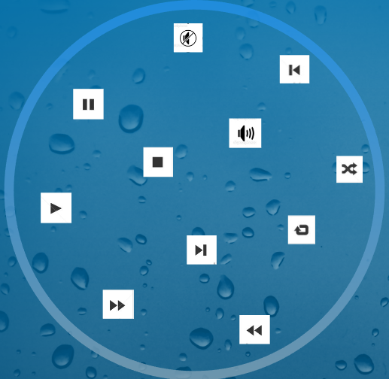
Existing System
Current music players have features such as
Play
Play Next
Play Previous
Pause
Shuffle

Slide 6
Proposed System
This system will generate a playlist based on the facial expression extracted from captured image of the person.
The system involves the image processing and facial detection processing, uses Rekognition service of AWS.
The proposed is not a normal system, in this if the person’s expression is sad, fear, anger or disgust then it will play songs quite opposite to that expressions as to overcome their mood from the present mood by listening pleasant music.
If the person expression is happy, surprise, neutral, confused it will play songs accordingly.

Slide 7
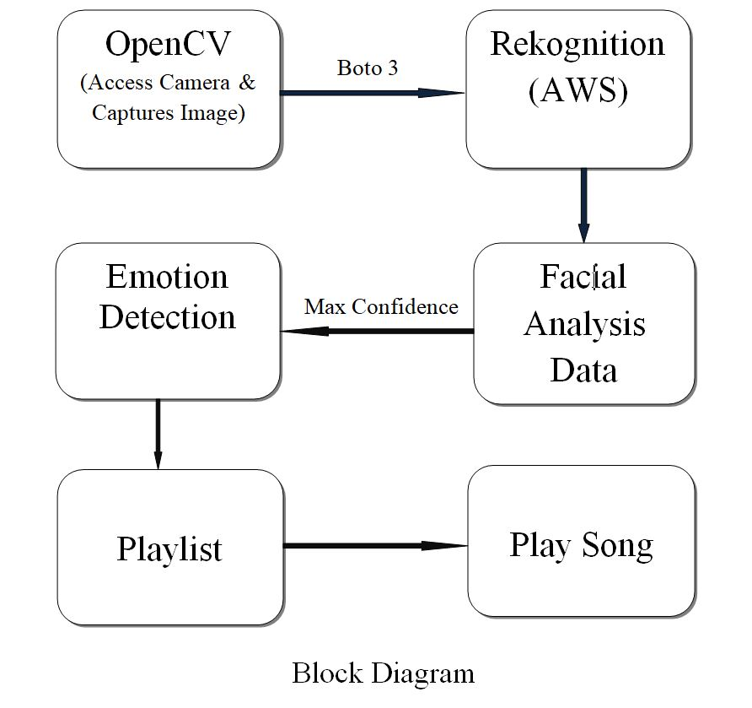

Slide 8
Software Modules
Open CV
Boto3
AWS - Rekogntion
Python - Language

Slide 9

Open CV
Open CV (Open Source Computer Vision Library) is an open source computer vision and machine learning software library.
It was built to provide a common infrastructure for computer vision applications and to accelerate the use of machine perception in the commercial products.
In simple language it is a library used for Image Processing. It is mainly used to do all the operation related to Images.
Features of Open CV Library
Read and write images
Capture and save videos
Process images (filter, transform)
Perform feature detection

Slide 10
Applications of Open CV
Gesture recognition
Human-computer interaction
Mobile robotics
Segmentation and recognition
Motion tracking
Augumented reality
Machine learning

Slide 11

Boto 3
Boto is the Amazon Web Services (AWS) SDK for Python, which allows Python developers to write software that makes use of Amazon services like S3 and EC2.
Boto derives its name from the Portuguese name given to types of dolphins native to the Amazon River.
Boto provides an easy to use, object-oriented API as well as low-level direct service access.
Boto is a Python package that provides interfaces to Amazon Web Services.

Slide 12

Rekogntion - AWS
Amazon Rekognition makes it easy to add image and video analysis to your applications using proven, highly scalable, deep learning technology that requires no machine learning expertise to use.
With Amazon Rekognition, you can identify objects, people, text, scenes, and activities in images and videos, as well as detect any inappropriate content.
Amazon Rekognition also provides highly accurate facial analysis and facial search capabilities that you can use to detect, analyze, and compare faces for a wide variety of user verification, people counting, and public safety use cases.
Rekognition Image is an image recognition
service that detects objects, scenes, and faces;
extracts text; recognizes celebrities; and
identifies inappropriate content in images.

Slide 13
Amazon Rekognition returns the following facial attributes for each face detected, along with a bounding box and confidence score for each attribute:
Gender
Smile
Emotions
Eyeglasses
Sunglasses
Eyes open
Mouth open
Mustache
Beard
Pose
Quality
Face landmarks

Slide 14
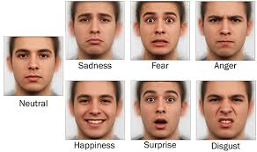
From all these facial attributes we need only emotion attribute to detect emotions
The seven universally classified emotions are
Happy
Sad
Anger
Disgust
Fear
Surprise
Neutral

Slide 15
Advantages
User friendly
To reveal from stress
Based On Facial Expressions
Easy of use
Mixed mood detection
Reduced computational time
Web Application

Slide 16
Limitations
Shuffled songs may not match the mood of the user.
Time consuming.
Sensitive to lighting conditions.

Slide 17
Future scope
The future scope in the system would to design a mechanism that would help in music therapy treatment and provide the music therapist the help needed to treat the patients suffering from disorders like mental stress , anxiety acute depression.
The proposed system also tends to avoid in future the unpredictable results produced in extreme light conditions and very poor camera resolution.

Slide 18
Conclusion
Music Player has changed in many different ways since it was first introduced. Now-a-days people like to get more out of different applications, so the designing of applications and the thought process behind it has changed. The users prefer more interactive & sophisticated yet simple to use applications.
The proposed work presents facial expression recognition system to play a song according to the expression detected. It uses REKOGNITION service of AWS to extract features. In this work, real images i.e. user dependent images are captured utilizing the in-built camera by using OpenCV. The final result is obtained in the form of maximum confidance level of different expressions.

Slide 19
THANK YOU

